Slide 1
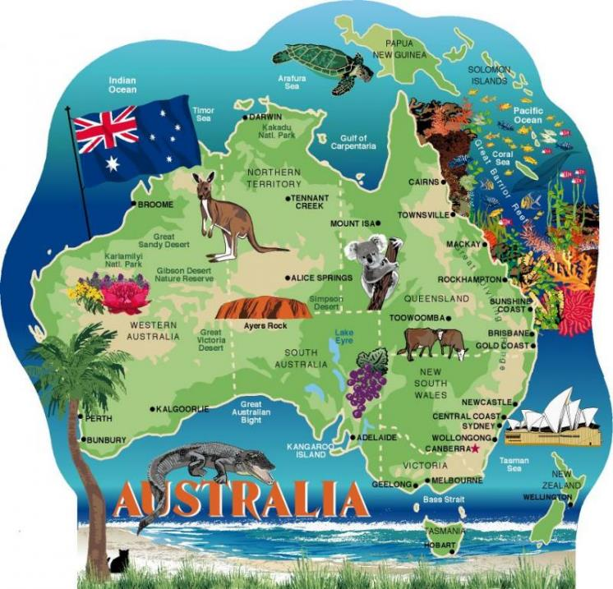
Visitation of
Sr. Marife Mendoza and
Sr. Elly van Dijk
11 November –
13 December
2017

Slide 2
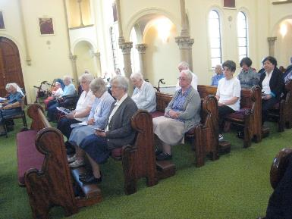
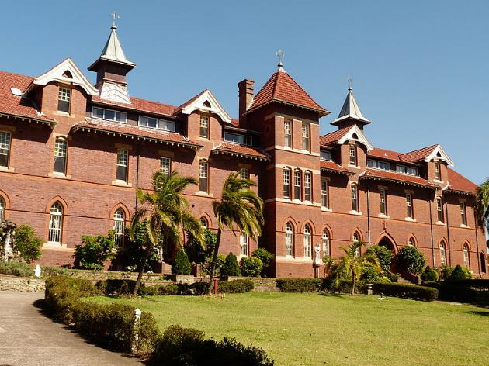
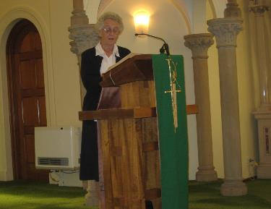
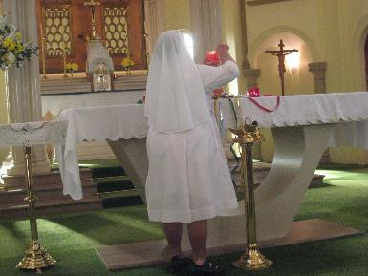
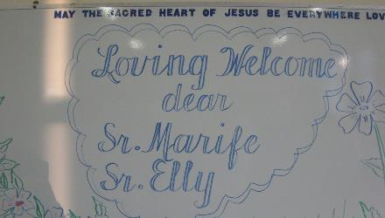
Arrival in Sydney and official Welcome Celebration

Slide 3
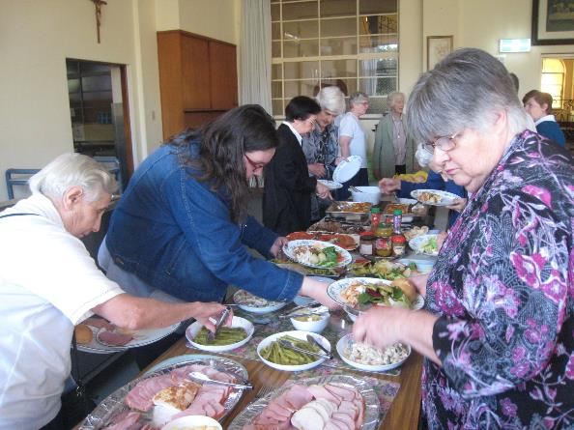
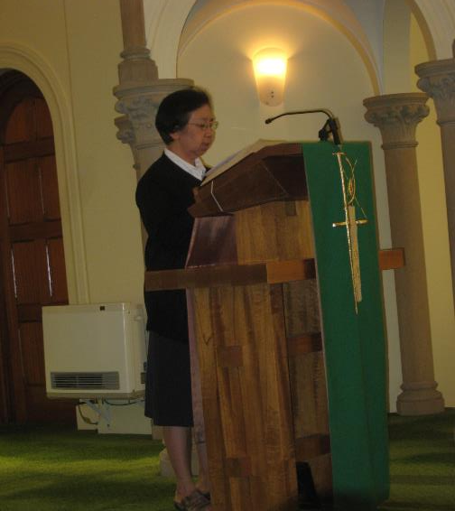
followed by a nice meal
with our Sisters and Associates

Slide 4
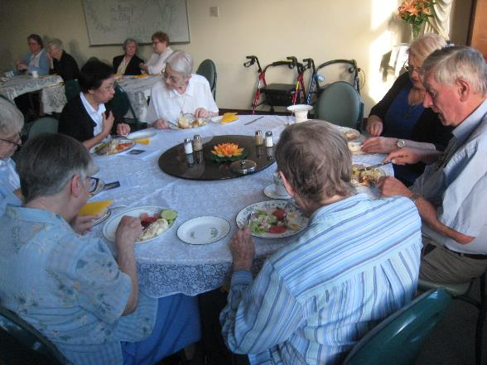
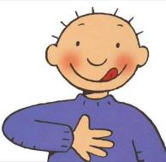
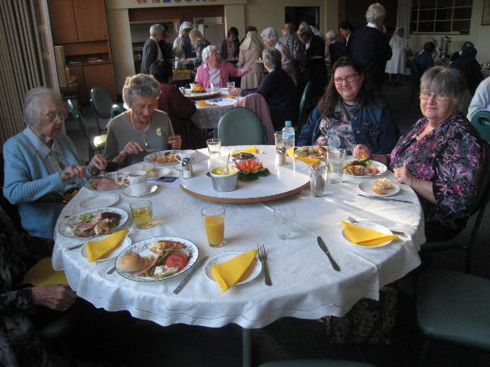

Slide 5
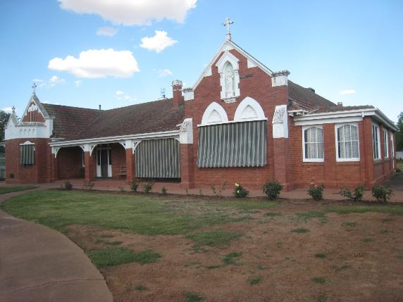
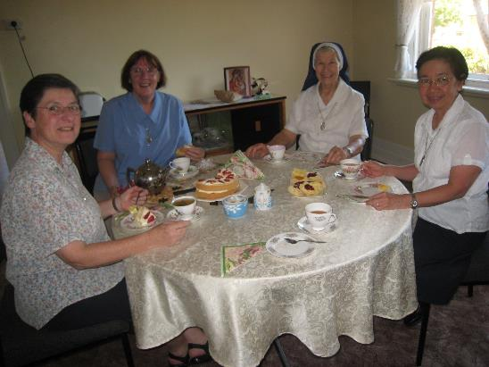
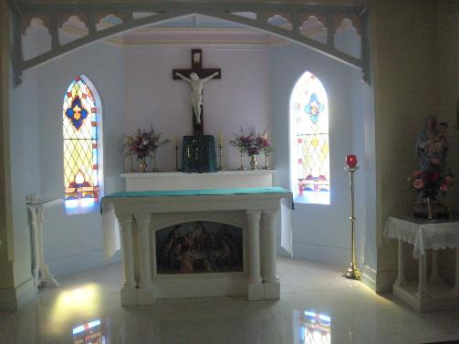
Afternoon Tea with
our Sisters in Elmore

Slide 6
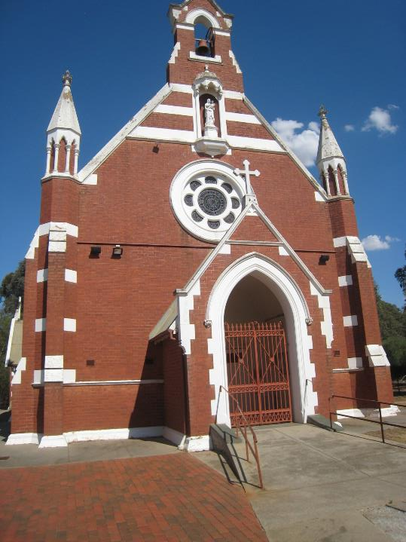
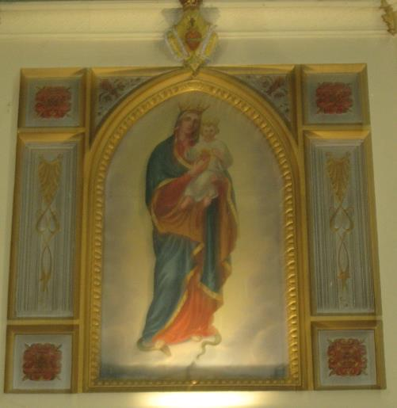
Our Lady of the Sacred Heart was already there when the first sisters arrived in Elmore in 1929

Slide 7
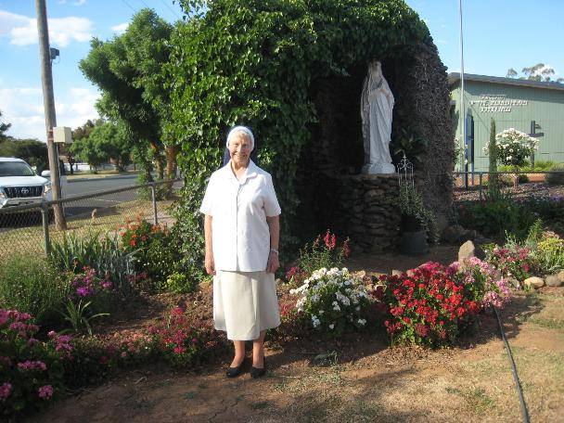
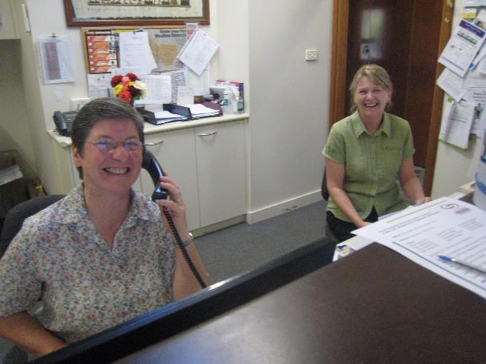
Sr. Lee working as a medical secretary
Sr. Shirley and her “Garden Ministry”

Slide 8
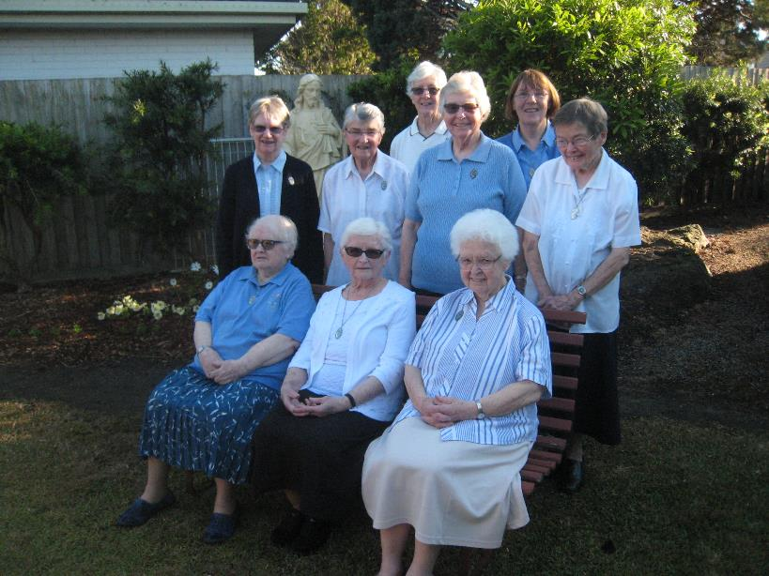
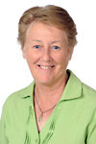
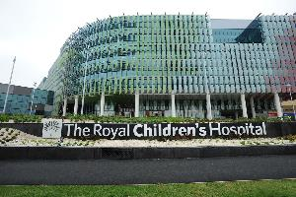
Community in Bentleigh
and Sr. Helen Little who works in the Children’s Hospital

Slide 9
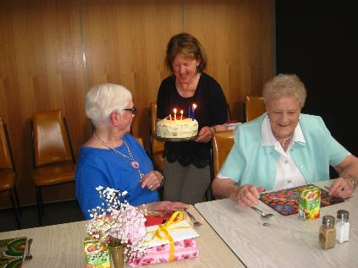
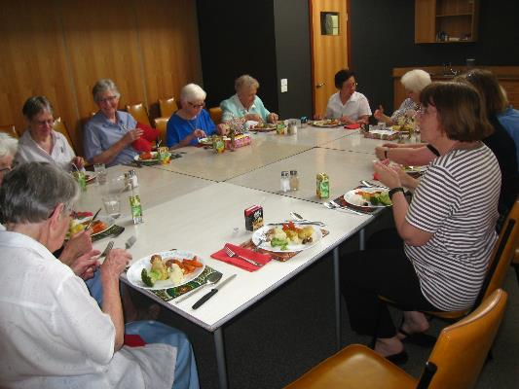
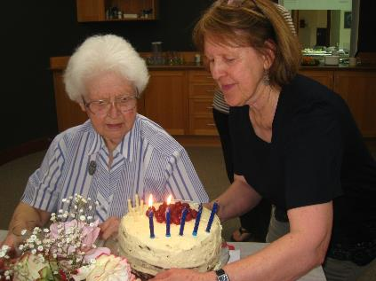

Slide 10
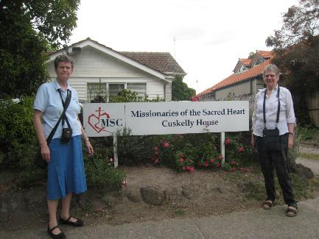
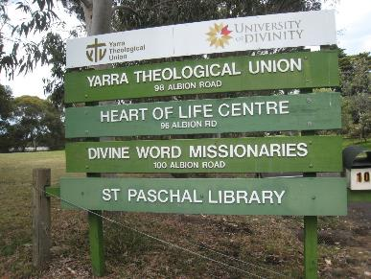
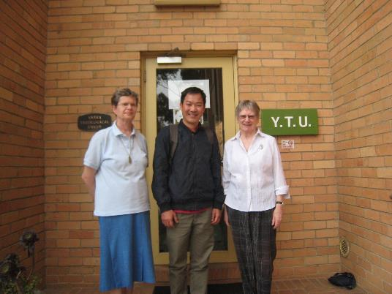
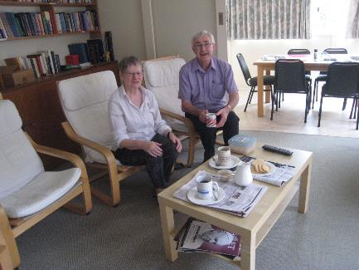
Sr. Robyn and Sr Elly visited
Yarra Theological Union and the MSC in Cuskelly House

Slide 11
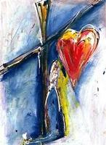
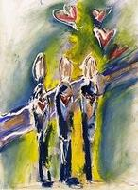
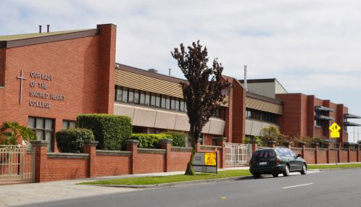
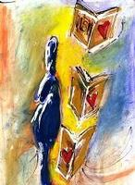
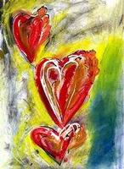
Sr. Marife and Sr. Elly visited
Our Lady of the Sacred Heart College, Bentleigh.
The four pillars of OLSH education are:
We are Heart people who are Faith-filled
We are Heart people who Reverence Relationships
We are Heart people who Pursue Excellence
We are Heart people who Touch the Hearts of Others

Slide 12
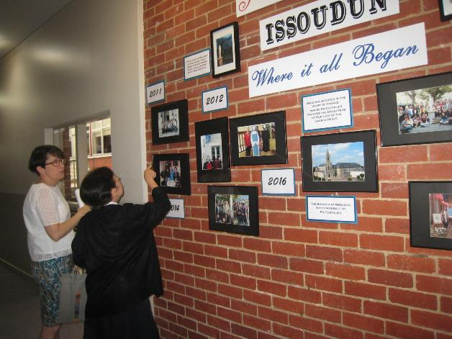
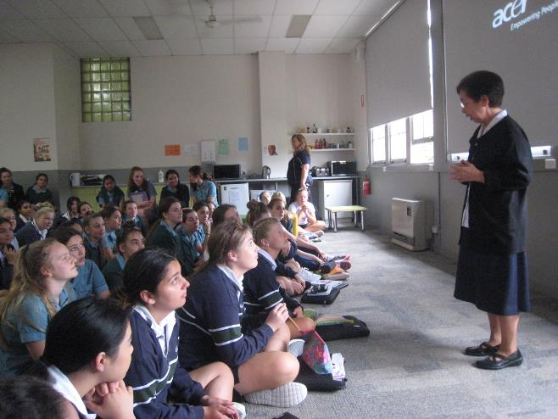
The Principal, Anne O’Loughlin and two students showed us around
and Sr. Marife had an encouraging word for the students and the teachers

Slide 13
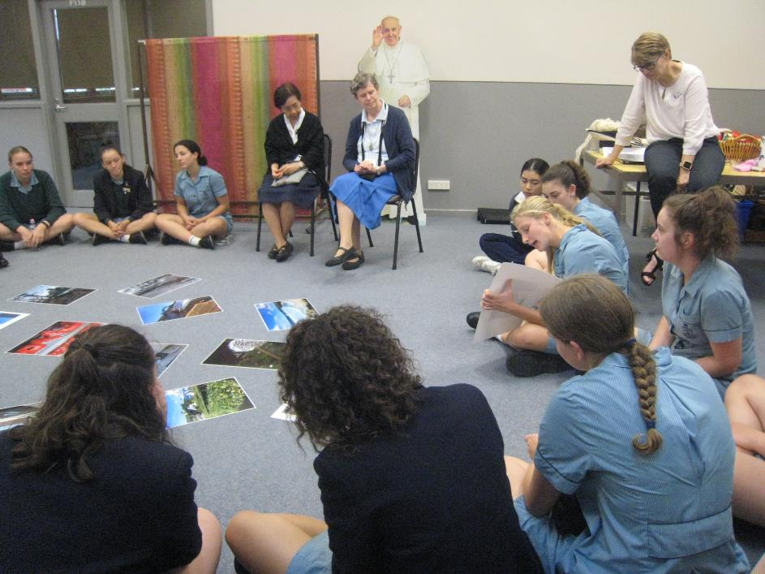
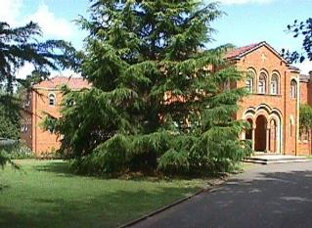
Students showed us their photos to explain what the “Issoudun experience” (a four week residential stay in Hartzer Park) had meant to them

Slide 14
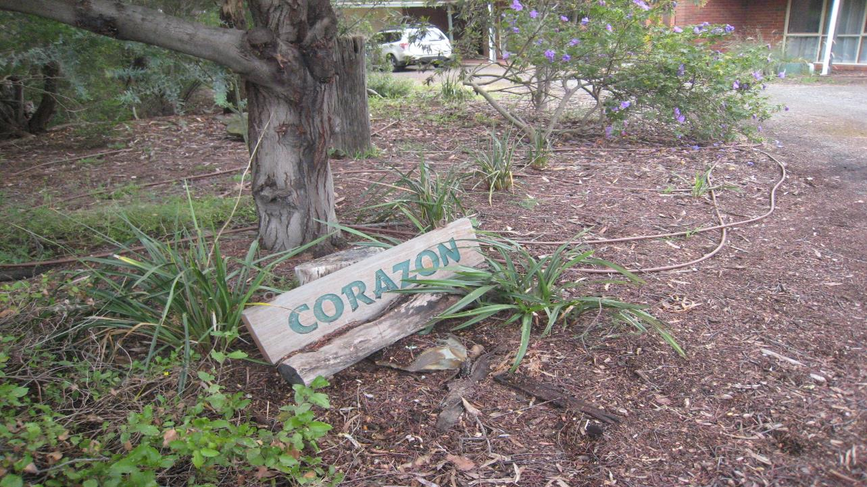
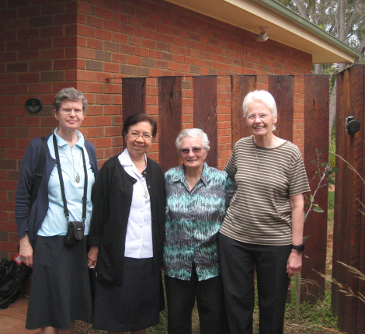
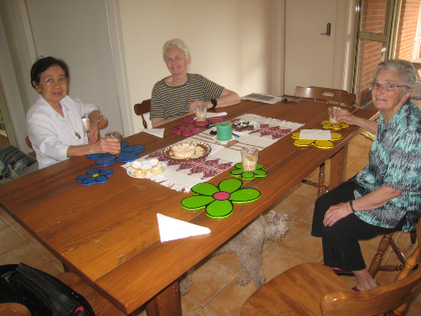
Sr. Jenny and Sr. Fiona in Corazon Centre in Werribee

Slide 15
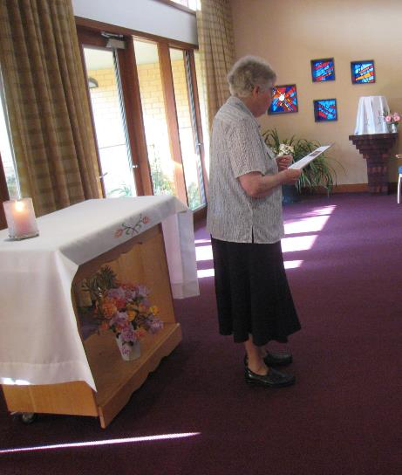
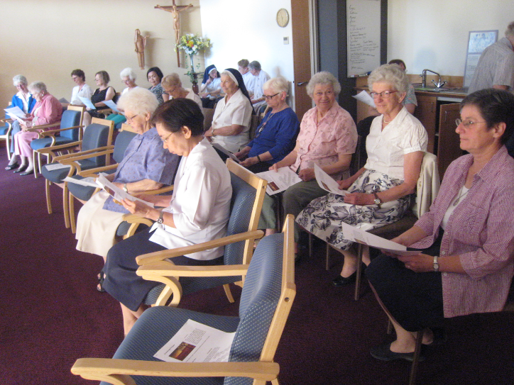
Evening prayer with the sisters of Bentleigh Community
and many guests to say farewell

Slide 16
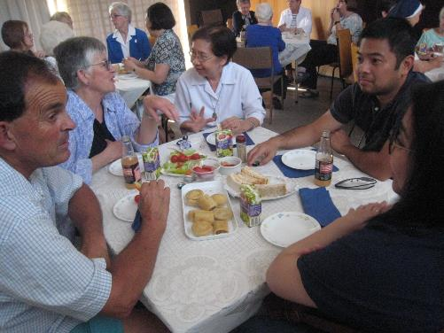
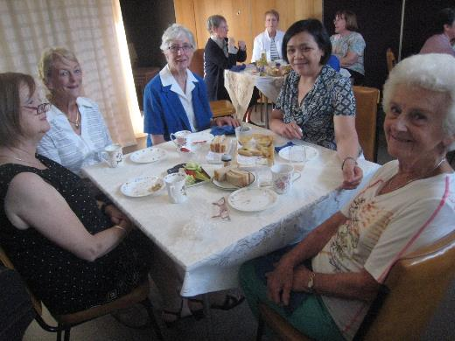
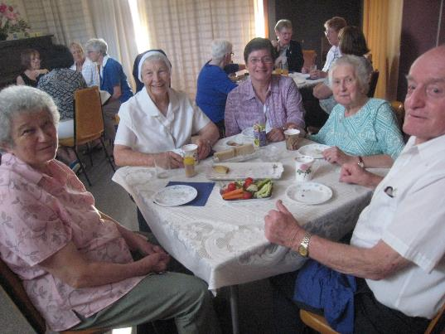
Followed by a farewell party

Slide 17
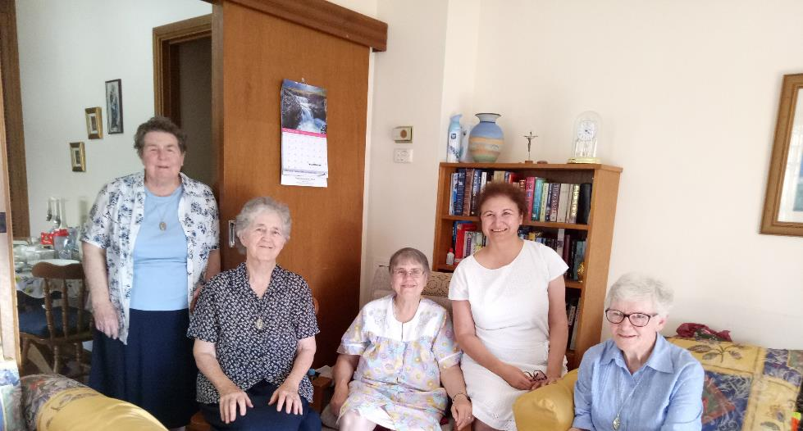
The Kilburn Community

Slide 18
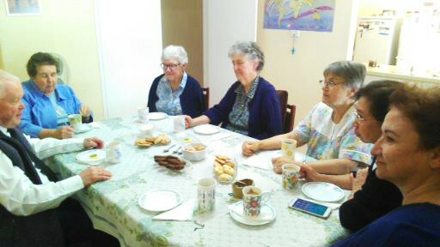
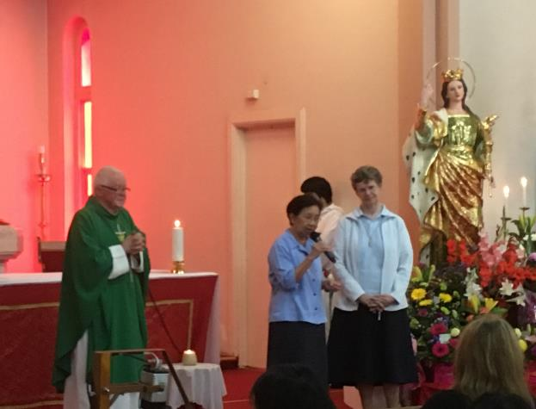
Coffee with the Community and Father Leon, the parish priest who introduced us in the parish of Kilburn

Slide 19
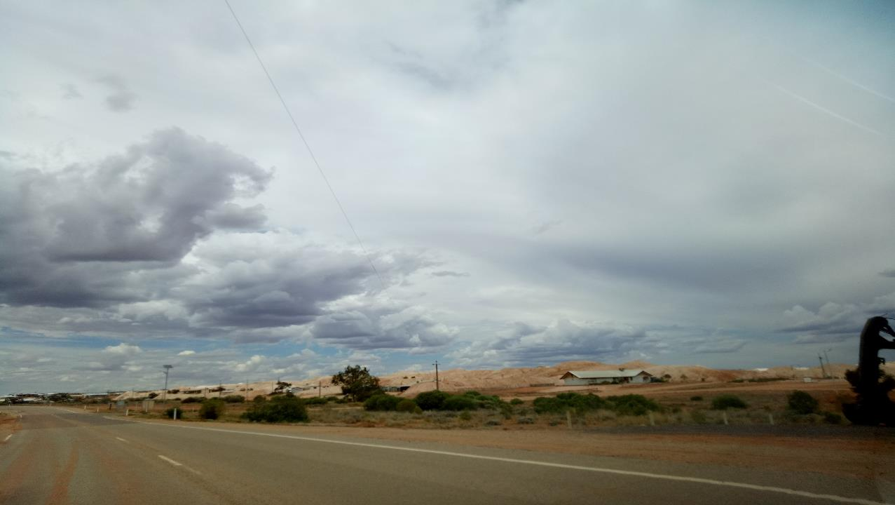
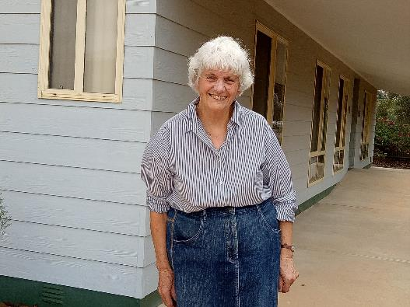
Sr. Patricia in Roxby Downs

Slide 20
St. Barbara’s Primary School in Roxby Downs

Slide 21
One of the teachers is Filipina.
She came to visit us.
Sr. Patricia, cooking a delicious meal

Slide 22
Visiting Andamooka
known for its opal mining

Slide 23
Mary MacKillop Museum in North Sydney

