Slide 1
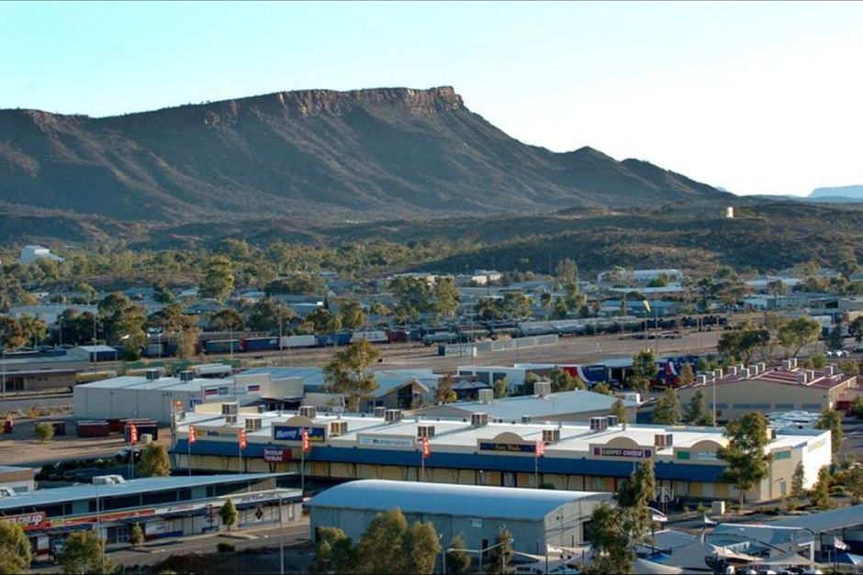
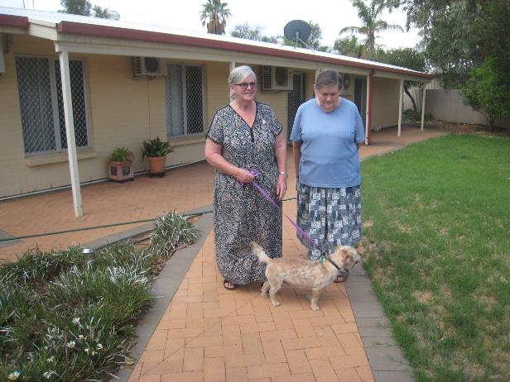
Our Sisters in Alice Springs
View from ANZAC Hill

Slide 2
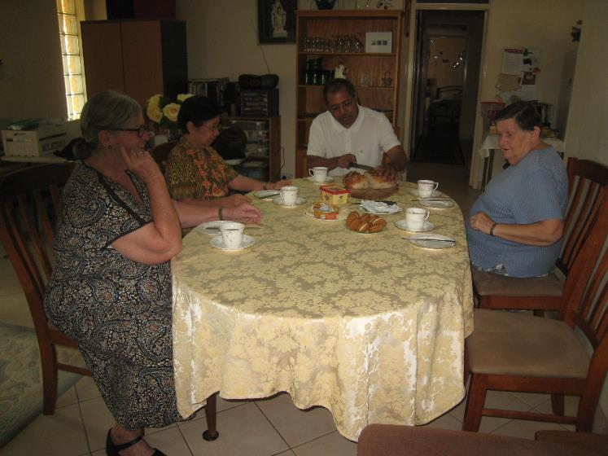
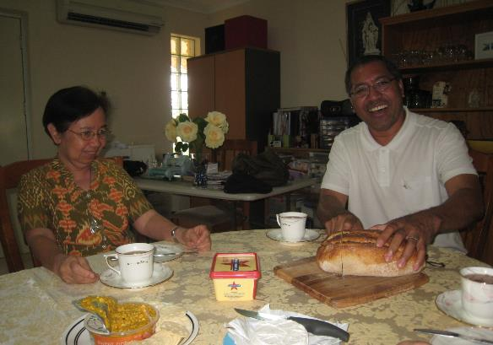
Our Sisters with
Father Raass SVD

Slide 3
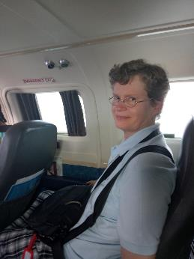
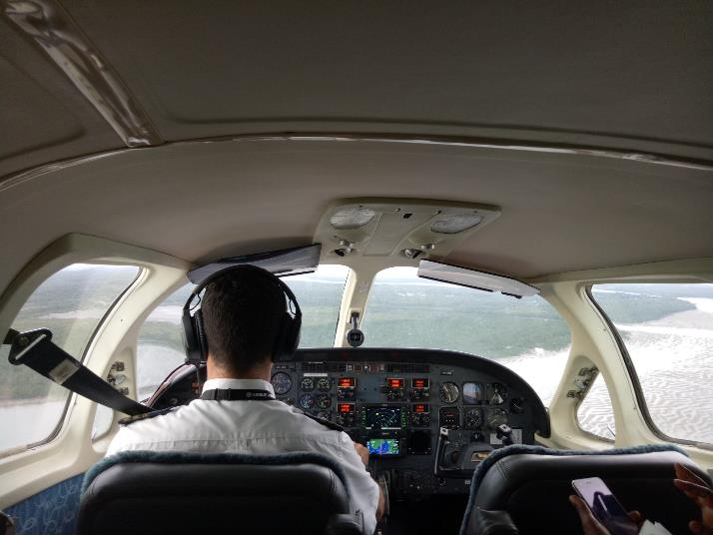
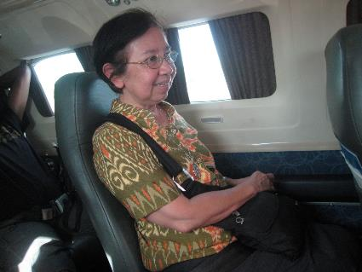
In a nine-seater to Bathurst Island

Slide 4
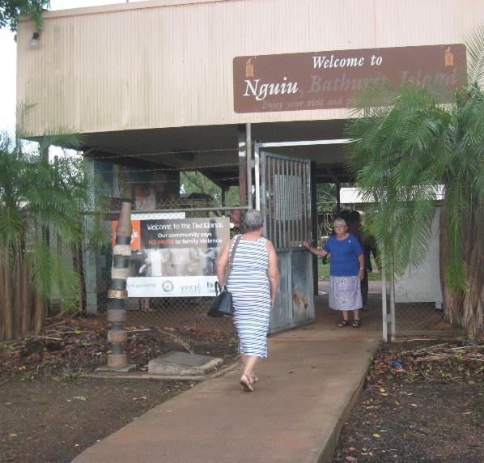
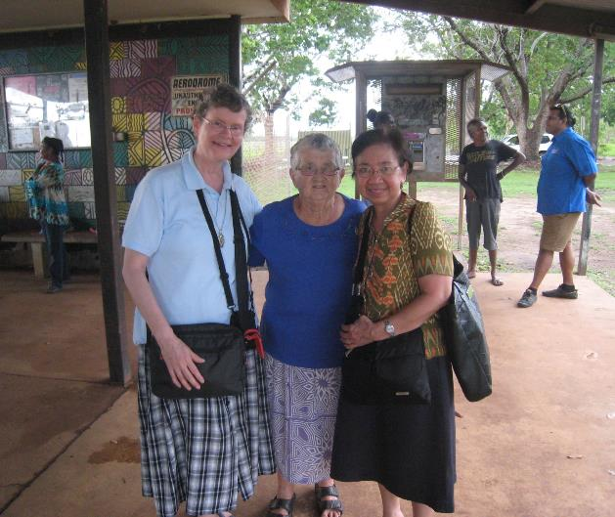
Where Sr. Anne was already waiting

Slide 5
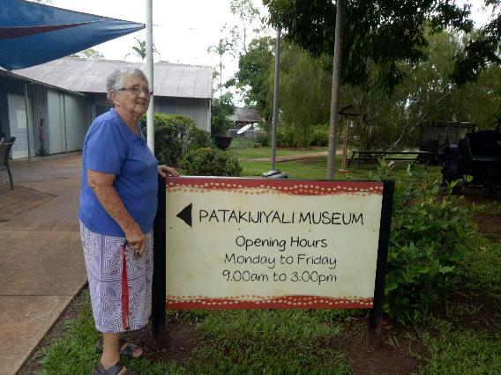
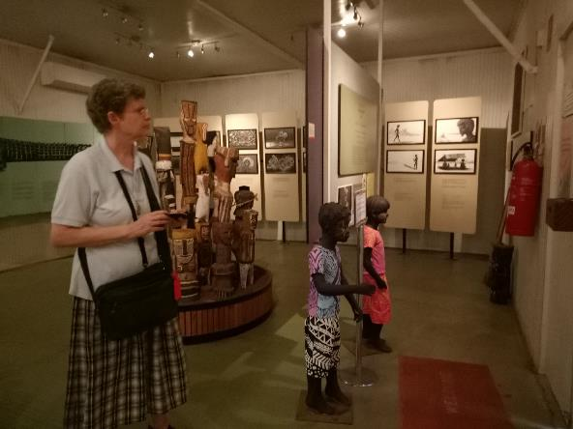
Sr Anne brought us to her marvellous Patakijiyali Museum, which she began in the 1980s.
Now it is one of the most outstanding socio-ethnic institutions in Australia.

Slide 6
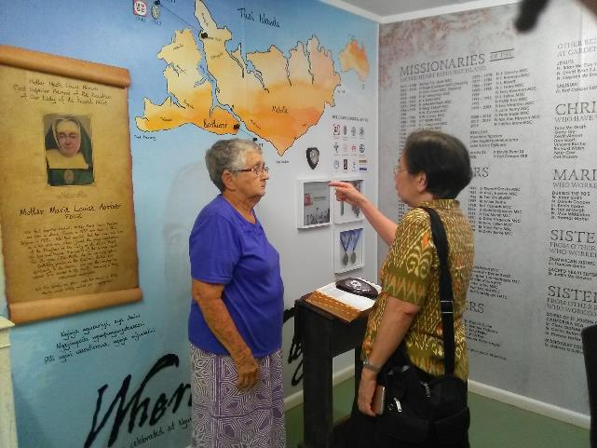
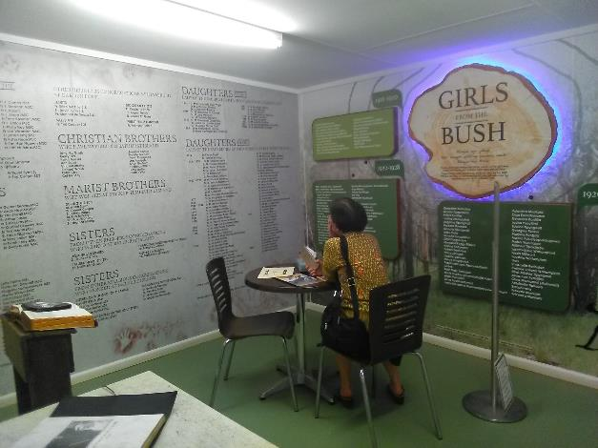
Sr. Marife took time to reflect in the room where all the names of our sisters who have worked on Bathurst Island are recorded.

Slide 7
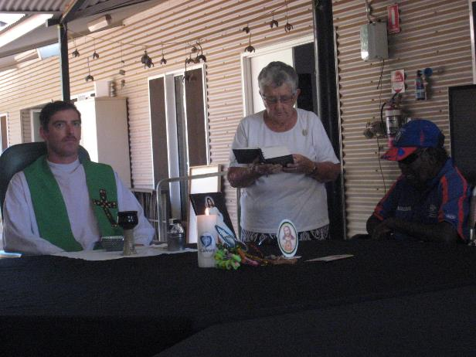
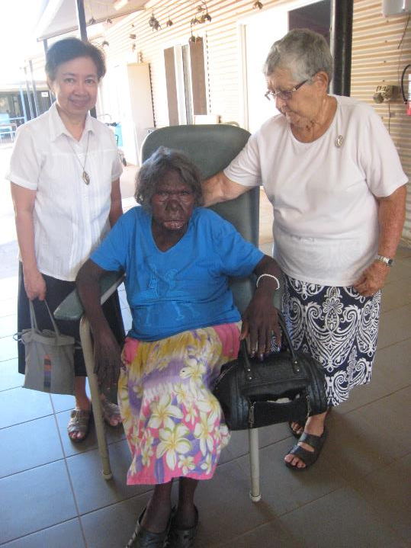
Mass in the Aged Care Centre

Slide 8
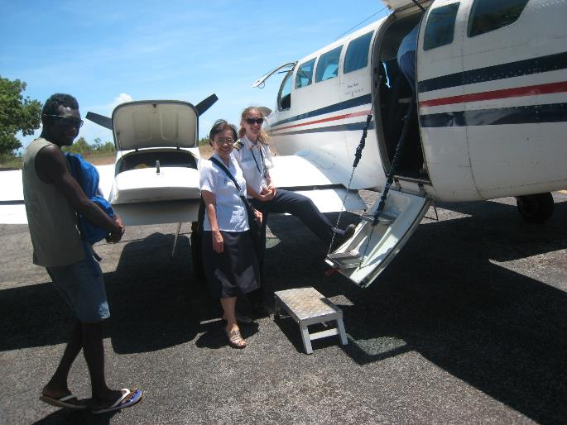
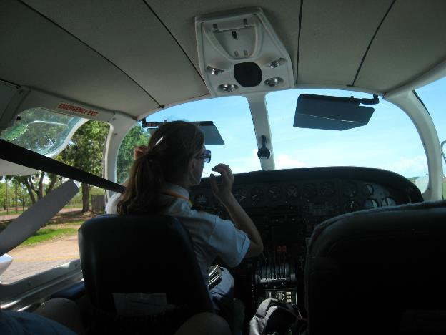
Time to go again…..
on our way to Darwin

Slide 9
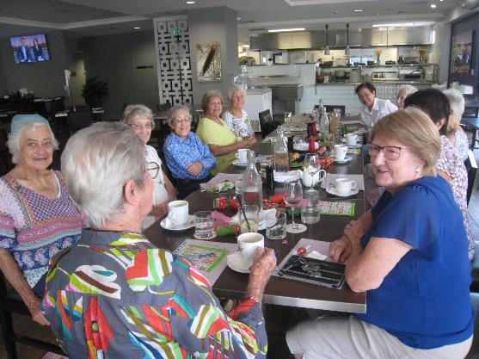
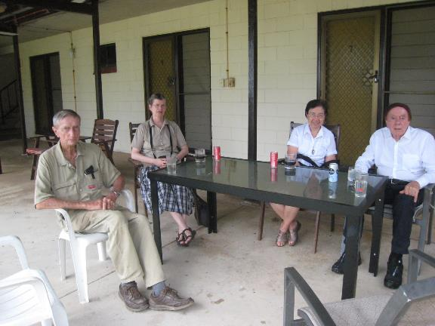
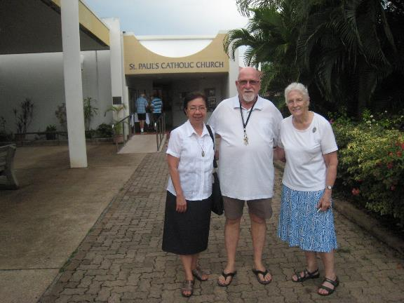
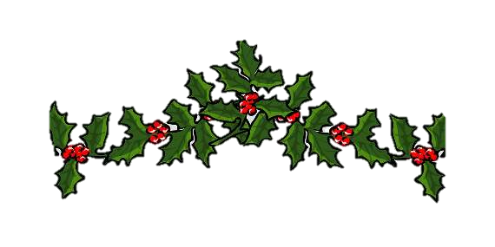
visit to Fr Malcolm Fyfe and Br Ted MSC.
Christmas party with the Associates
And to Fr Roy O’Neill MSC in his parish.

Slide 10
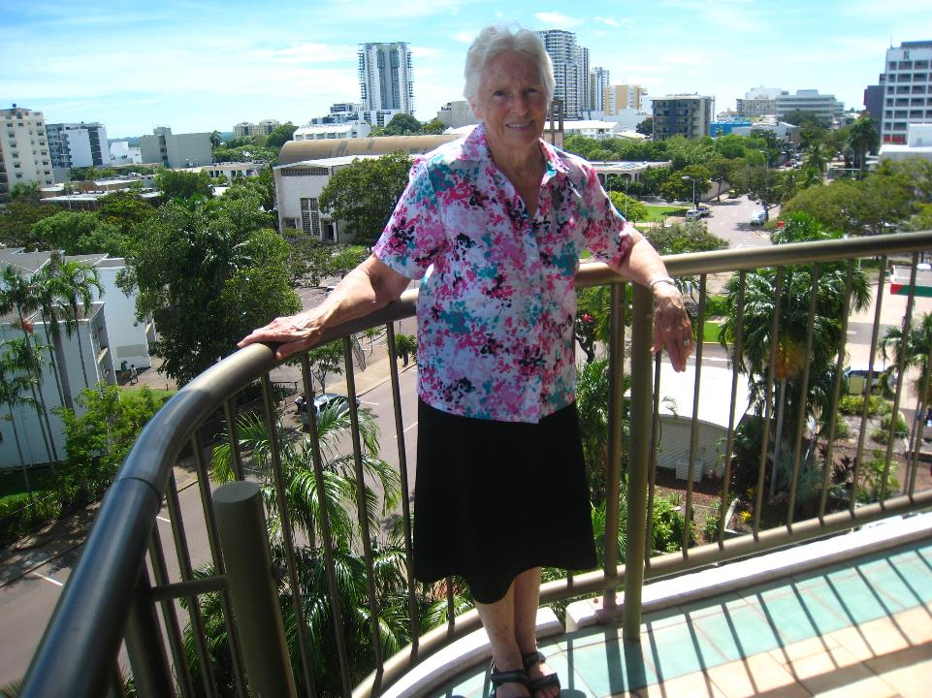
Sr. Mary on the balcony of her apartment which has a beautiful view over Darwin

Slide 11
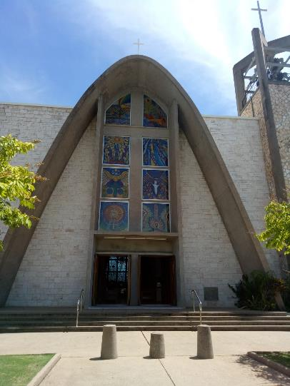
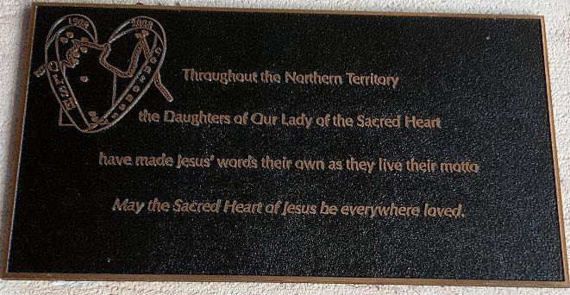
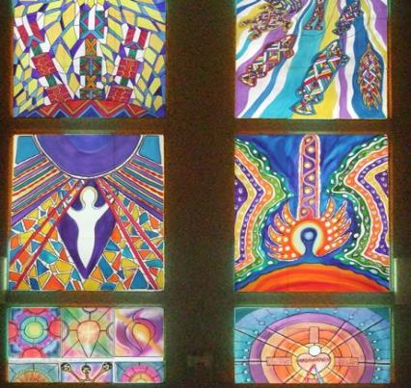
In St. Mary’s Cathedral in Darwin, there are many reminders of the work our Sisters have done in the Northern Territory

Slide 12
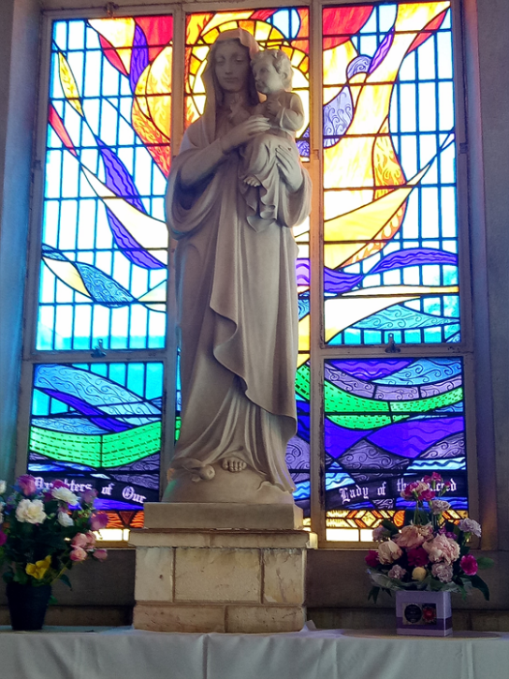
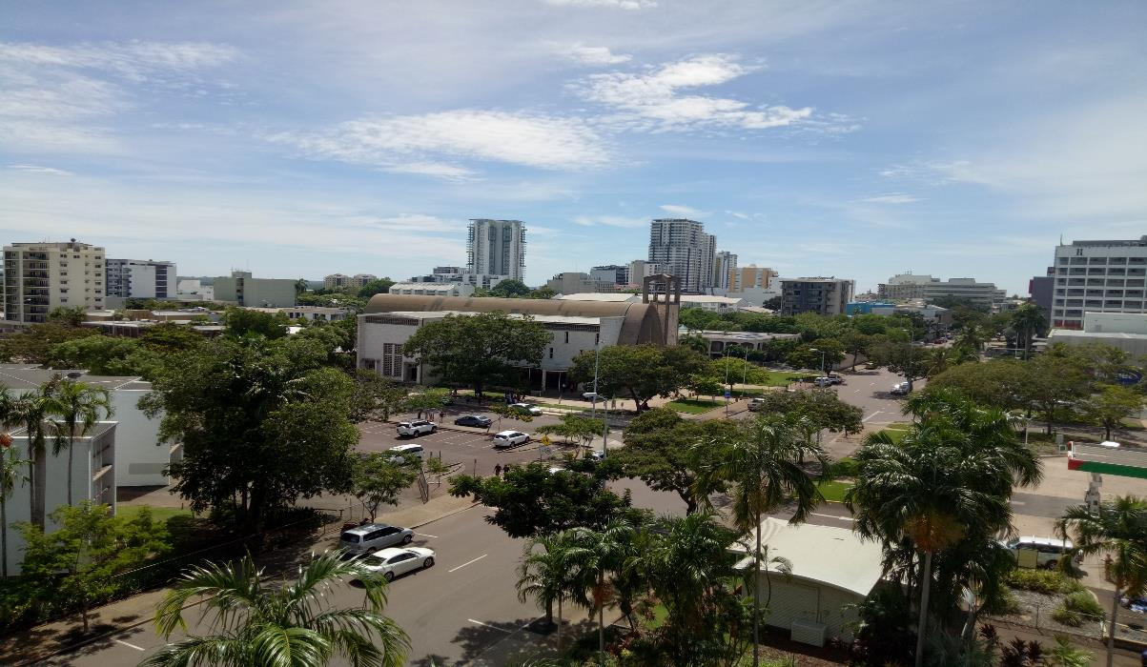

Slide 13
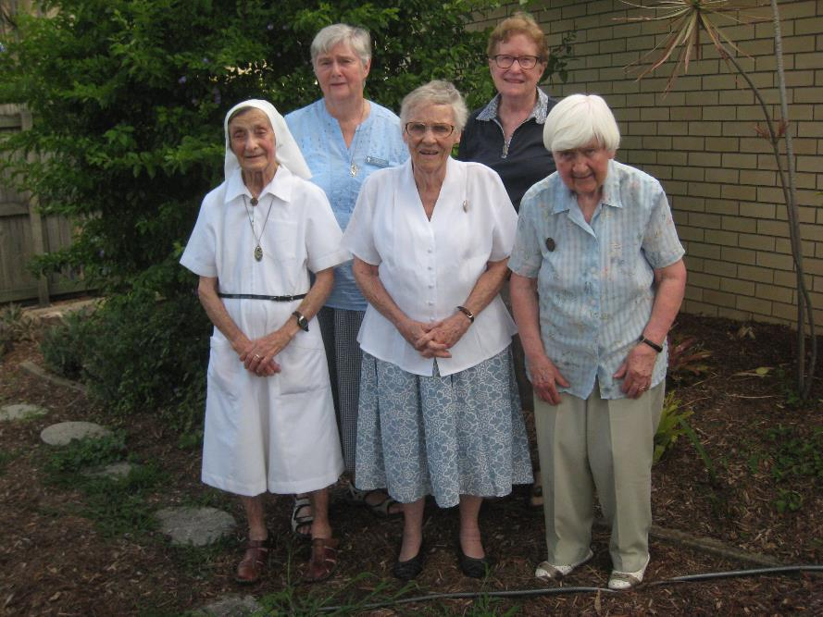
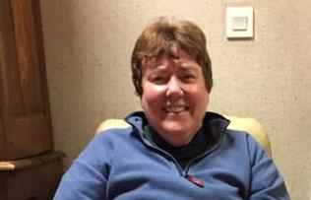
Our Community in Corinda

Slide 14
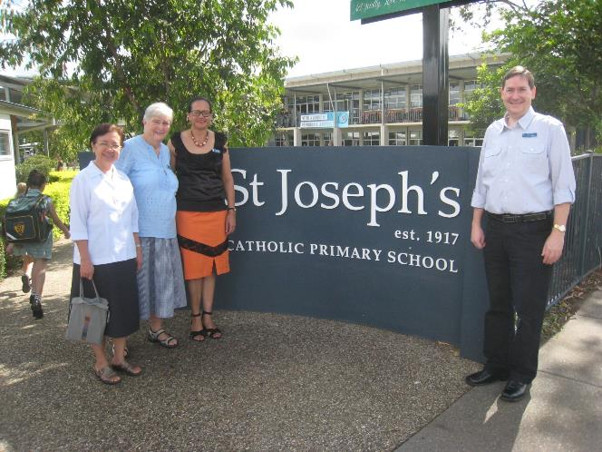
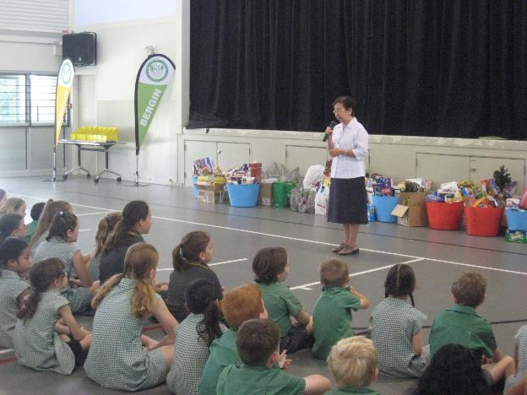
Visit to St. Joseph’s Primary School
Sr. Marife, Sr. Merrilyn, the Pastoral Associate and Michael Doherty, the coordinator of the parish in Corinda.

Slide 15
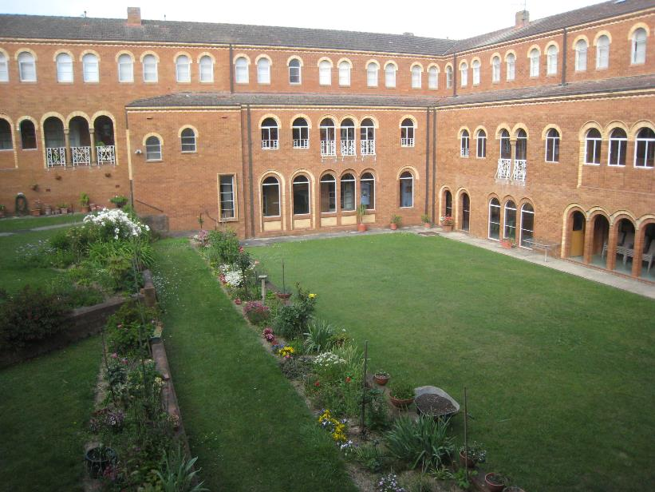
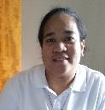
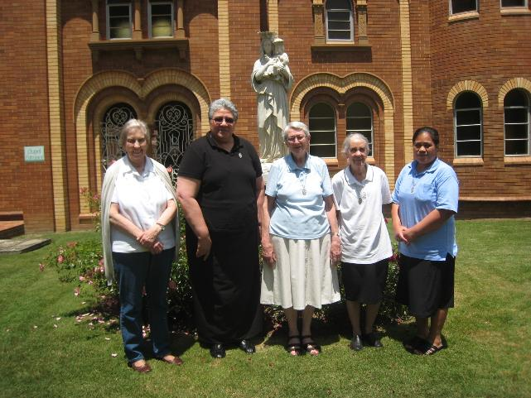
Community in Hartzer Park,
Burradoo

Slide 16
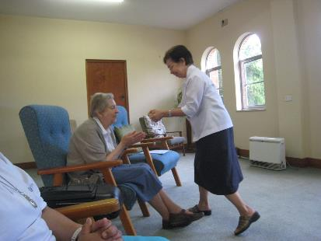
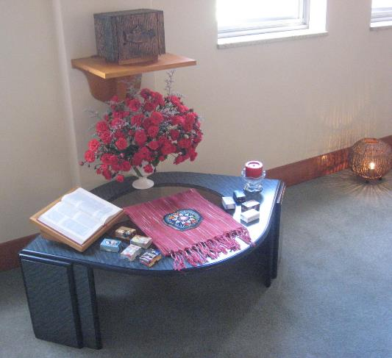
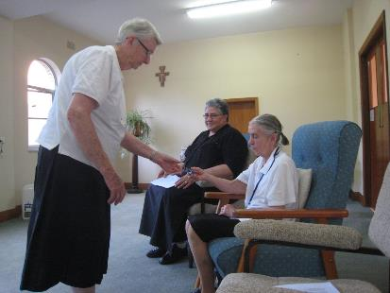
During Evening Prayer we were invited to live this time of Canonical Visitation as the Gift of Encounter

Slide 17
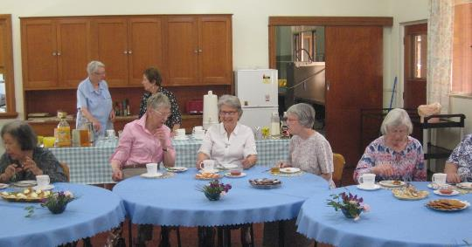
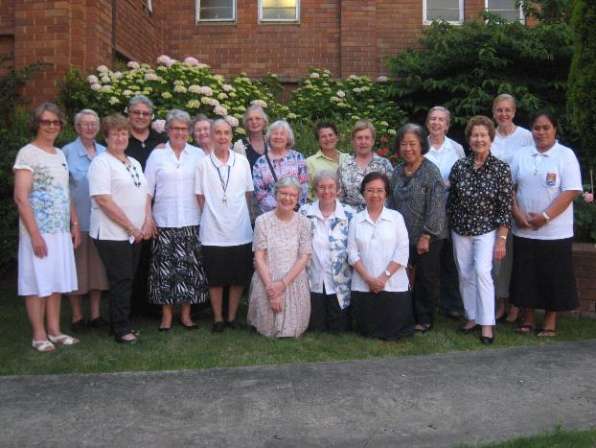
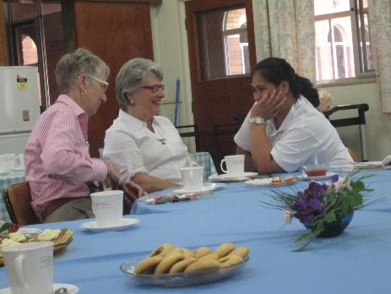
We had a nice afternoon with our Associates

Slide 18
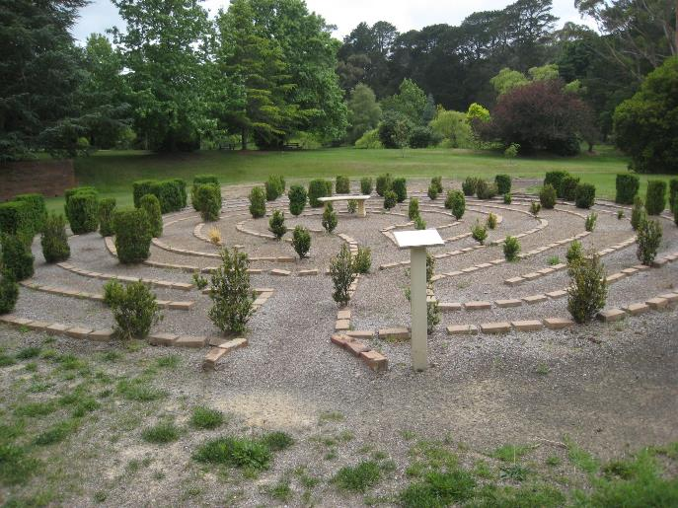
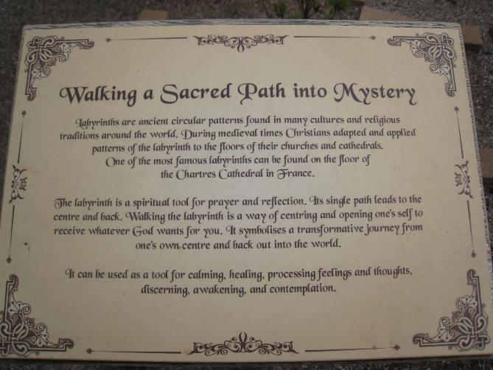
Walking through the Labyrinth we reflected on our experiences
and we were very grateful

Slide 19
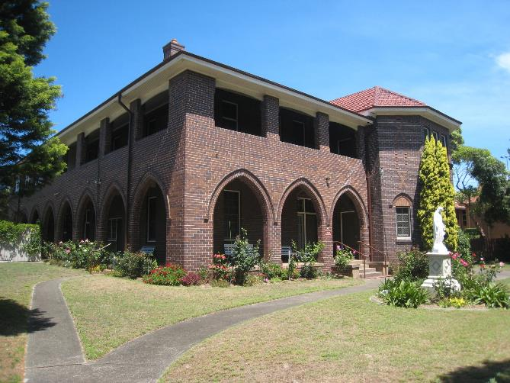
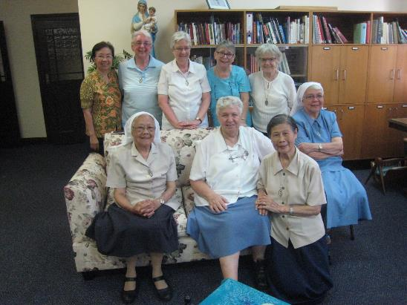
Our Community in Daceyville

Slide 20
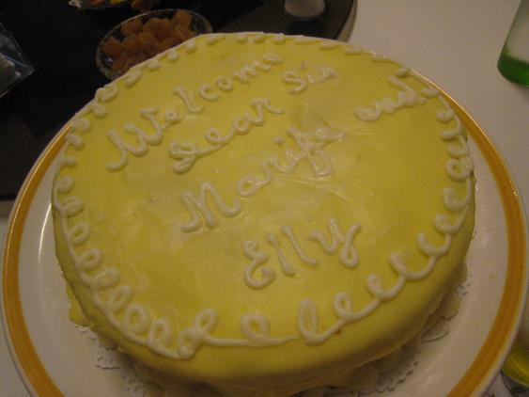
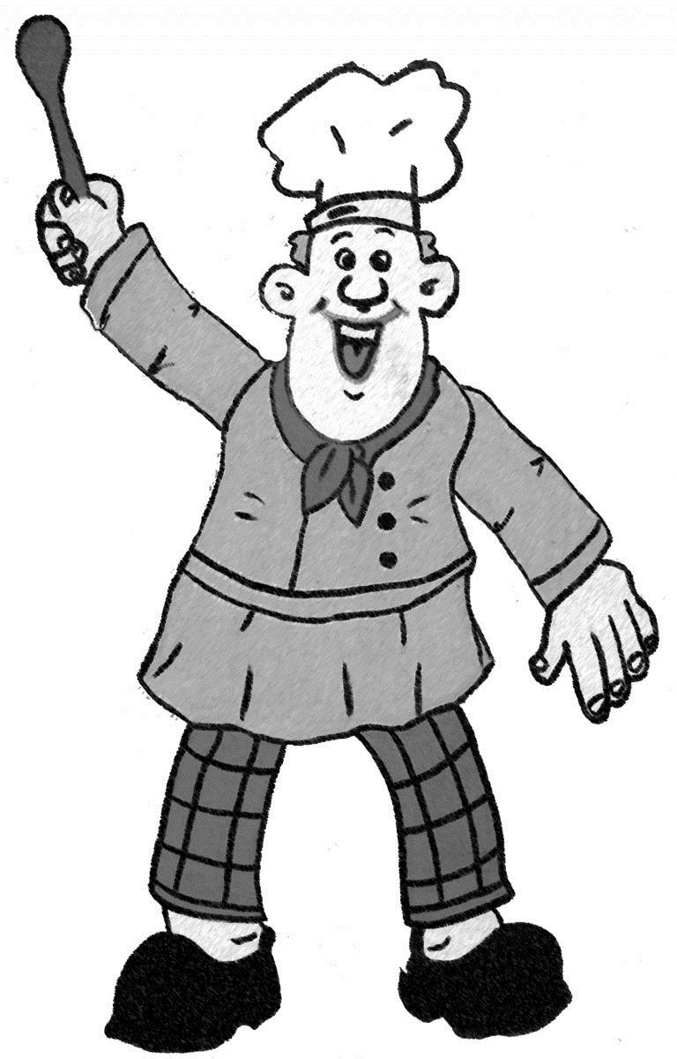
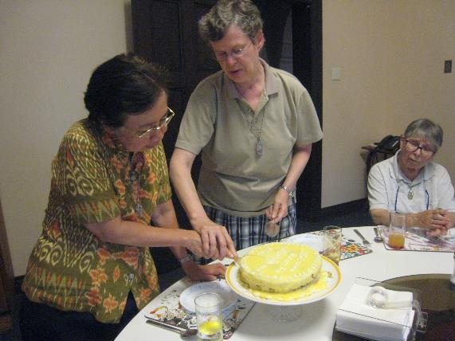
The sisters welcomed us with a special cake

Slide 21
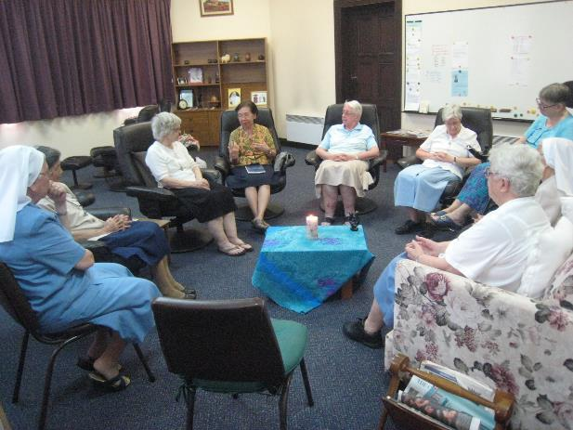
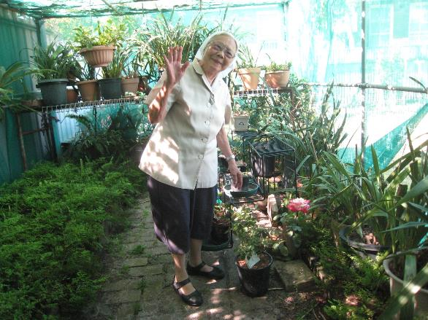
Sr. Betty in her greenhouse
Community Meeting

Slide 22
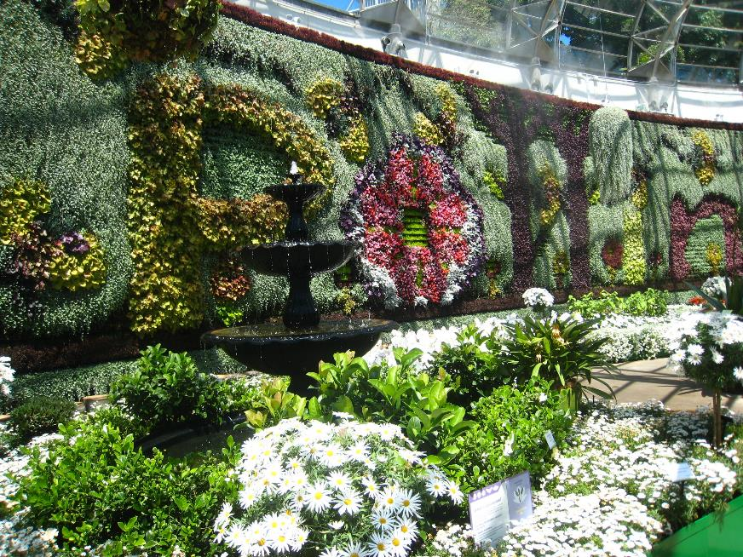
Sr. Helen and Sr. Elly visiting the Botanic Gardens in Sydney

Slide 23
St. Joseph’s Aged Care Facility

Slide 24
Sr. Robyn at reception
A lay staff member with Sr. Pauline, Director of Nursing and Sr. Elizabeth community leader

