Slide 1
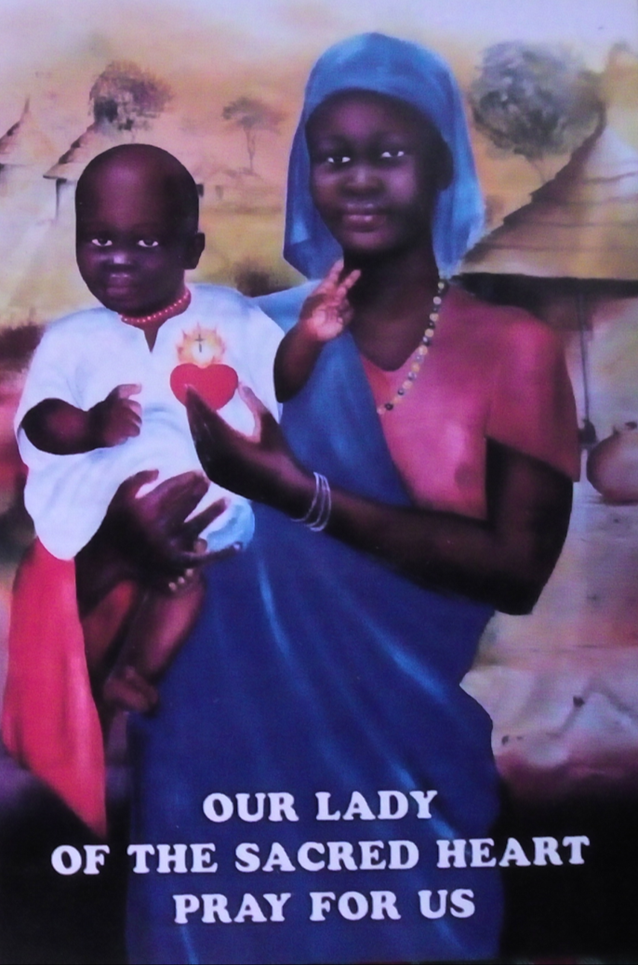
Visitation in South Sudan
13 to 24 February 2018

Slide 2
FDNSC Mapuordit Community
Sr Wendy Violet and Sr Rita Grunke

Slide 3
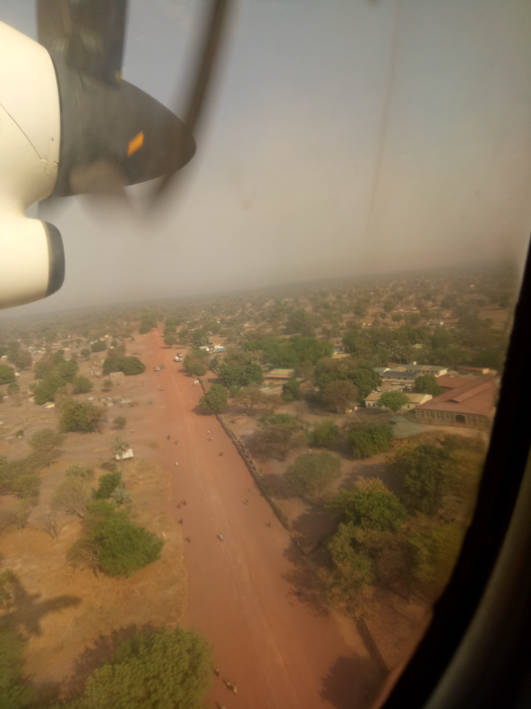
Voyage Rome to Juba via Addis Ababa
13 February 2018

Slide 4
In Juba, we were welcomed by Fr Christian, Vice Provincial of the Comboni Missionaries in South Sudan and other Comboni Missionaries
Sr Marife with Fr Christian and Br Pepo
Sr Merle with Fr Salvatore

Slide 5
On 14 Feb, Ash Wednesday, we arrived in Rumbek and we were met by Sr Rita. There we had a chance to have a short meeting (under a mango tree) with Fr John Mathiang, Diocesan Coordinator of Rumbek

Slide 6
Then, it was time for the 3 hour bumpy ride to Mapuordit… by the time we arrived, we did not only have ashes on our foreheads…
The very sturdy car of the OLSH in Mapuordit.
Guess what she is carrying!!!
No…that is not her luggage!

Slide 7
We finally arrived to the OLSH Compound, Mapuordit where we were lovingly welcomed by Sr Wendy

Slide 8
OLSH Compound
Dining Area
Evening meals outside

Slide 9
OLSH Compound
Chapel
Inside the Chapel

Slide 10
OLSH Compound
Rooms
Inside one of the rooms

Slide 11
OLSH Compound
On the way to the showers and toilets
Community meeting under a mango tree

